Slide 1
Chapter 3 – The Data Encryption Standard (DES)

Slide 2
Content of this Chapter
Introduction to DES
Overview of the DES Algorithm
Internal Structure of DES
Decryption
Security of DES

Slide 3
Content of this Chapter
Introduction to DES
Overview of the DES Algorithm
Internal Structure of DES
Decryption
Security of DES

Slide 4
Classification of DES in the Field of Cryptology
Cryptology
Cryptography
Cryptanalysis
Symmetric Ciphers
Asymmetric Ciphers
Protocols
Block Ciphers
Stream Ciphers
You are here!

Slide 5
DES Facts
Data Encryption Standard (DES) encrypts blocks of size 64 bit.
Developed by IBM based on the cipher Lucifer under influence of the National Security Agency (NSA), the design criteria for DES have not been published.
Standardized 1977 by the National Bureau of Standards (NBS) today called National Institute of Standards and Technology (NIST)
Most popular block cipher for most of the last 30 years.
By far best studied symmetric algorithm.
Nowadays considered insecure due to the small key length of 56 bit.
But: 3DES yields very secure cipher, still widely used today.
Replaced by the Advanced Encryption Standard (AES) in 2000
For a more detailed history see Chapter 3.1 in Understanding Cryptography

Slide 6
Block Cipher Primitives: Confusion and Diffusion
Claude Shannon: There are two primitive operations with which strong encryption algorithms can be built:
Confusion: An encryption operation where the relationship between key and ciphertext is obscured. Today, a common element for achieving confusion is substitution, which is found in both AES and DES.
Diffusion: An encryption operation where the influence of one plaintext symbol is spread over many ciphertext symbols with the goal of hiding statistical properties of the plaintext. A simple diffusion element is the bit permutation, which is frequently used within DES.
Both operations by themselves cannot provide security. The idea is to concatenate confusion and diffusion elements to build so called product ciphers.

Slide 7
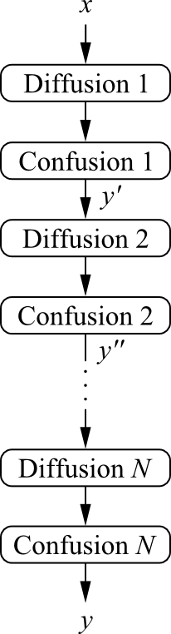

Product Ciphers
Most of today’s block ciphers are product ciphers as they consist of rounds which are applied repeatedly to the data.
Can reach excellent diffusion: changing of one bit of plaintext results on average in the change of half the output bits. Example:
single bit flip
many bit flips

Slide 8
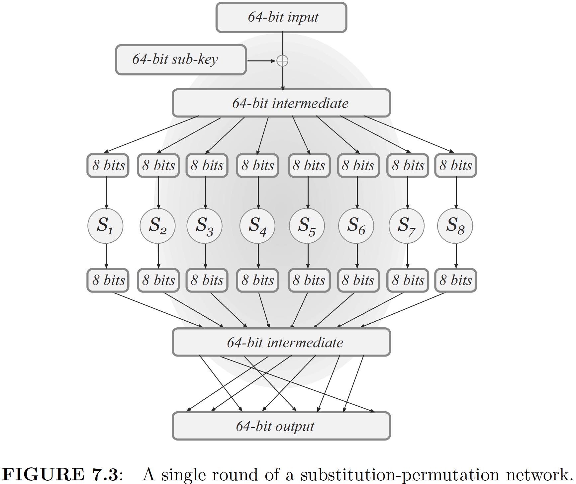
Design Paradigm: Substitution-Permutation Network

Slide 9
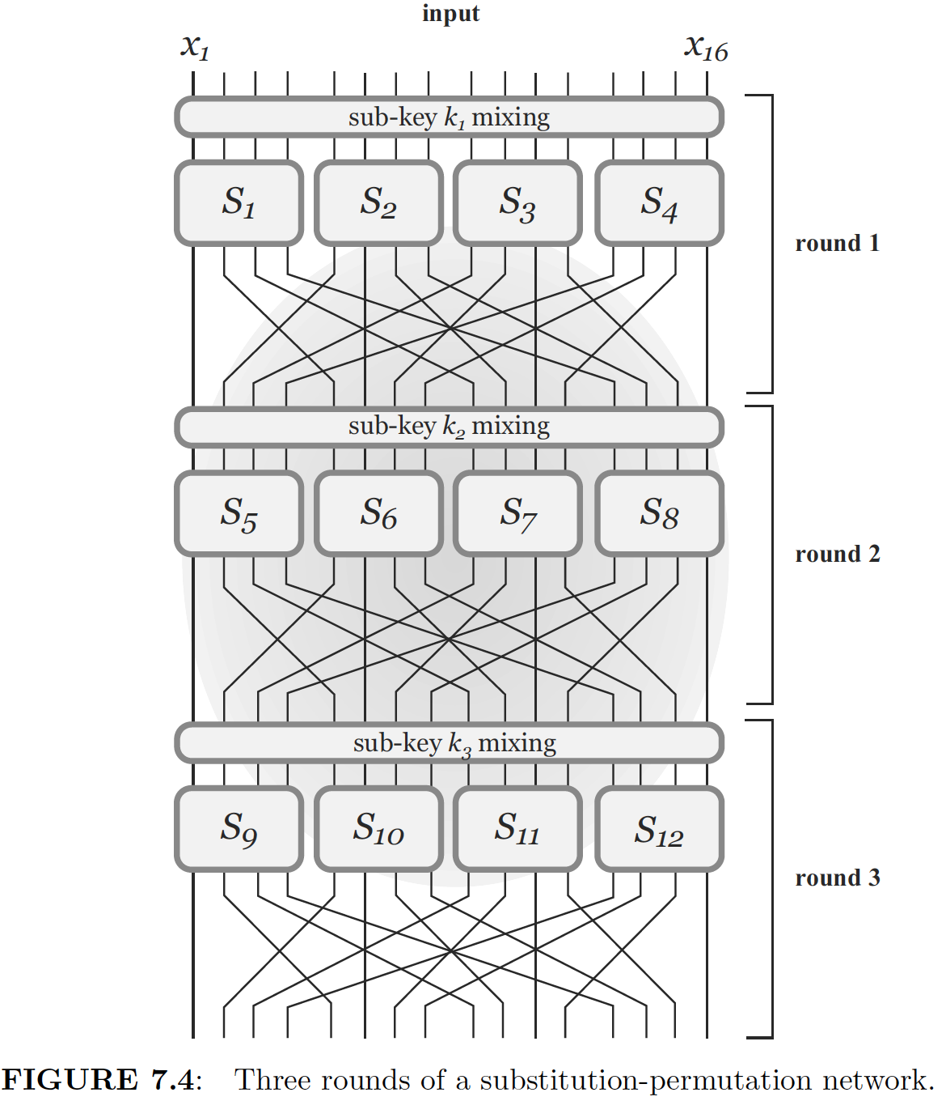

Three Round of a Substitution-Permutation Network
Changing of one bit of input bits results in the change of at least two bits of the output bits.

Slide 10
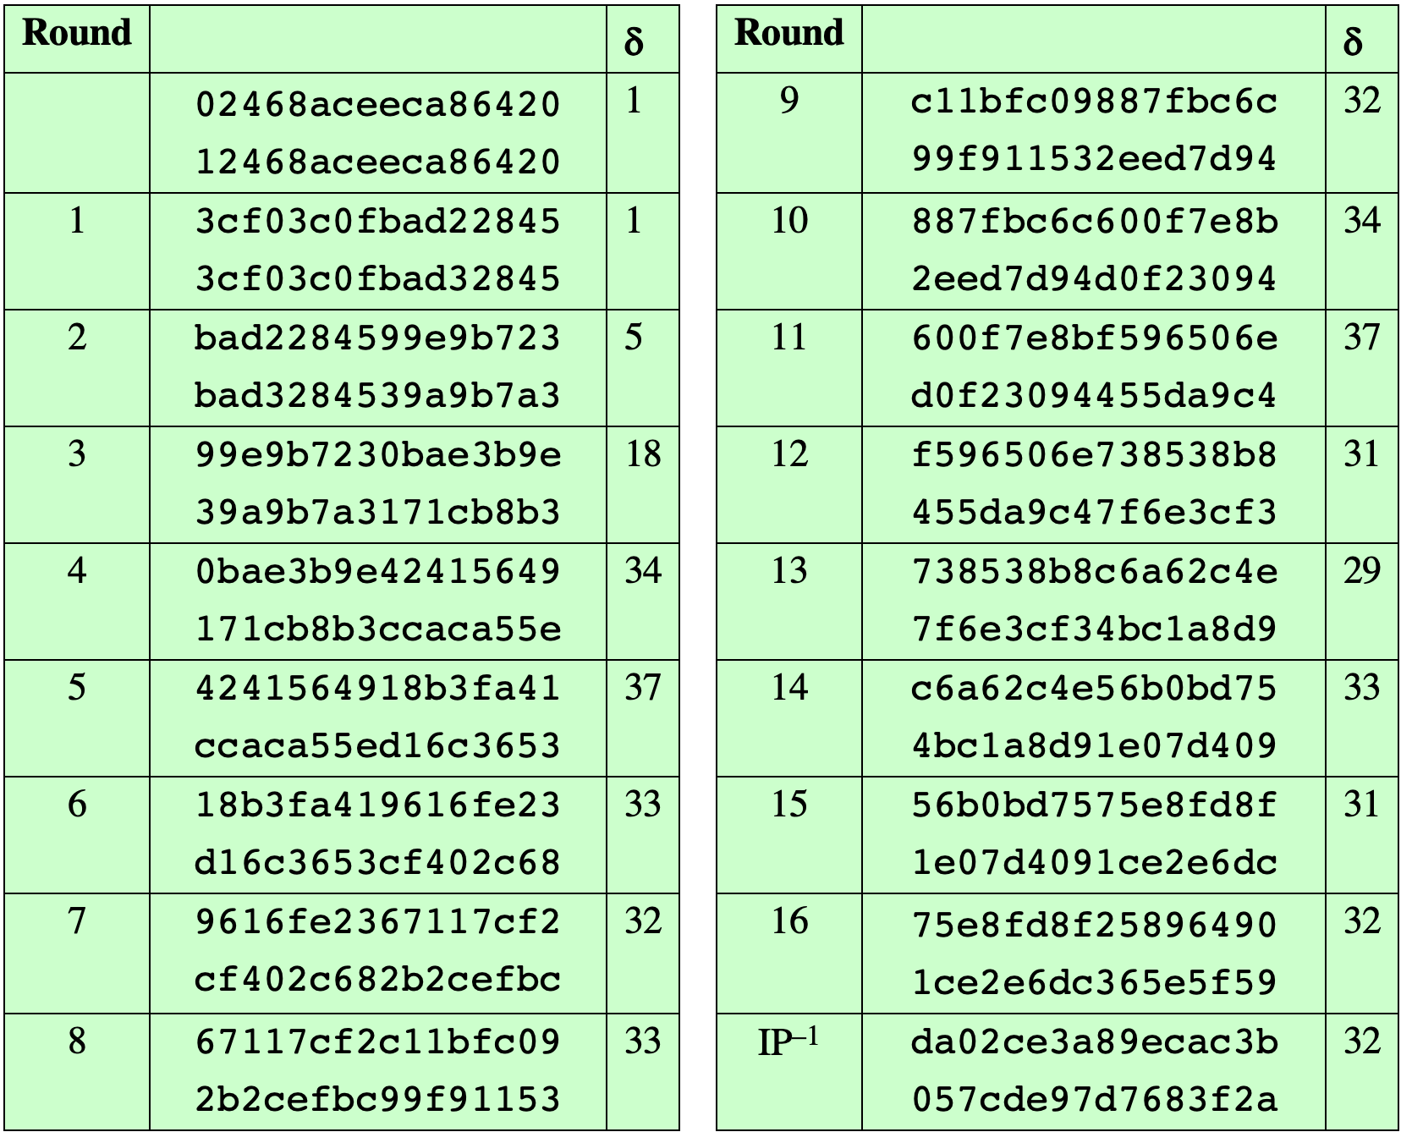
Avalanche Effect in DES: Change in Plaintext
Notes:
A desirable property of any encryption algorithm is that a small change in either
the plaintext or the key should produce a significant change in the ciphertext. In
particular, a change in one bit of the plaintext or one bit of the key should produce
a change in many bits of the ciphertext. This is referred to as the avalanche effect. If
the change were small, this might provide a way to reduce the size of the plaintext
or key space to be searched.
Using the example from Table 4.2, Table 4.3 shows the result when the fourth
bit of the plaintext is changed, so that the plaintext is 12468aceeca86420. The
second column of the table shows the intermediate 64-bit values at the end of each
round for the two plaintexts. The third column shows the number of bits that differ
between the two intermediate values. The table shows that, after just three rounds,
18 bits differ between the two blocks. On completion, the two ciphertexts differ in
32 bit positions.

Slide 11
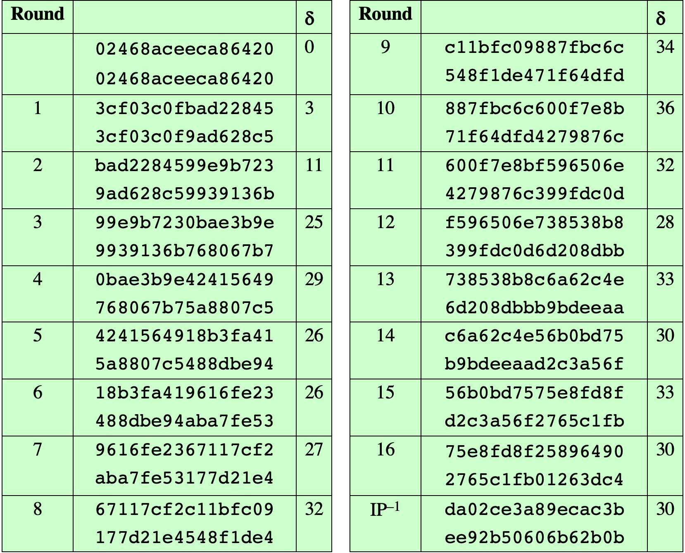
Avalanche Effect in DES: Change in Key
Notes:
Table 4.4 shows a similar test using the original plaintext of with two keys that
differ in only the fourth bit position: the original key, 0f1571c947d9e859, and
the altered key, 1f1571c947d9e859. Again, the results show that about half of
the bits in the ciphertext differ and that the avalanche effect is pronounced after just
a few rounds.

Slide 12
Content of this Chapter
Introduction to DES
Overview of the DES Algorithm
Internal Structure of DES
Decryption
Security of DES

Slide 13
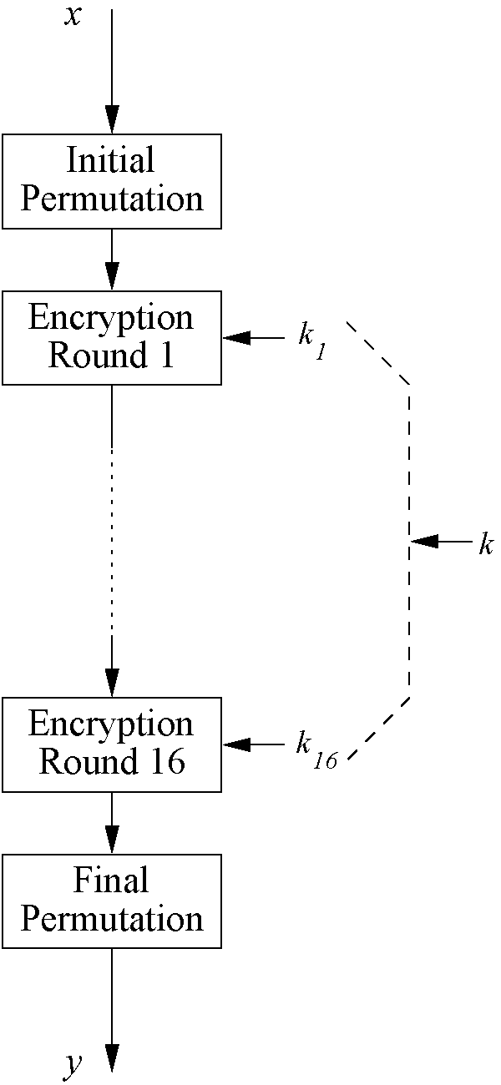
Overview of the DES Algorithm
Encrypts blocks of size 64 bits.
Uses a key of size 56 bits.
Symmetric cipher: uses same key for encryption and decryption
Uses 16 rounds which all perform the identical operation
Different subkey in each round derived from main key

Slide 14
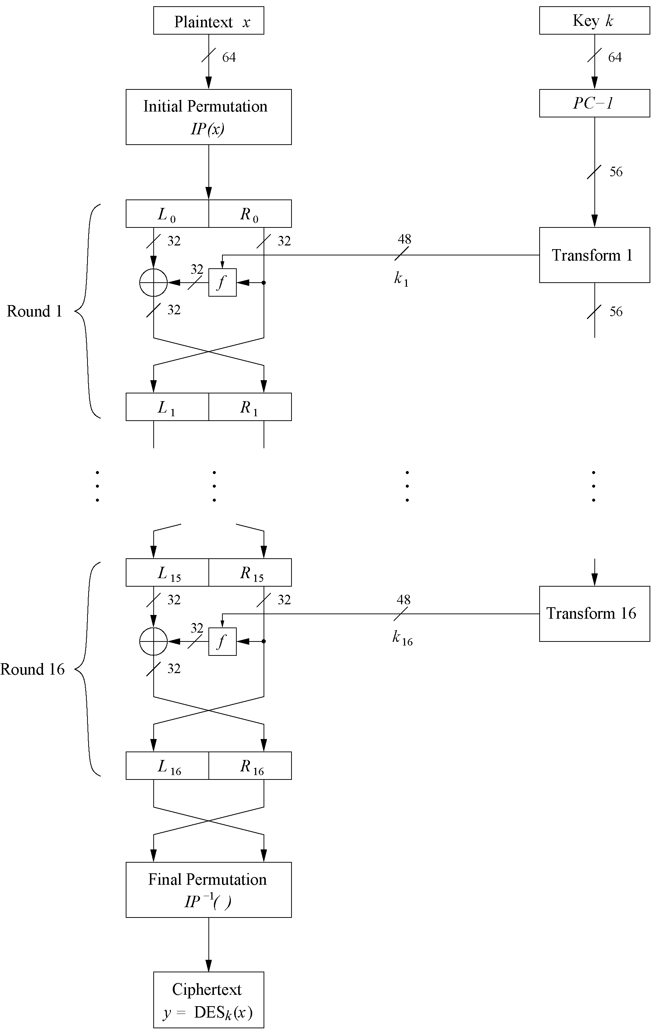
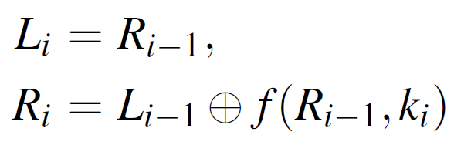
The DES Feistel Network (1)
DES structure is a Feistel network
Advantage: encryption and decryption differ only in keyschedule
Bitwise initial permutation, then 16 rounds
Plaintext is split into 32-bit halves L_{i} and R_{i}
R_{i} is fed into the function f, the output of which is then XORed with L_{i}
Left and right half are swapped
Rounds can be expressed as:

Slide 15
The DES Feistel Network (2)
L and R swapped again at the end of the cipher, i.e., after round 16 followed by a final permutation

Slide 16
Content of this Chapter
Introduction to DES
Overview of the DES Algorithm
Internal Structure of DES
Decryption
Security of DES

Slide 17
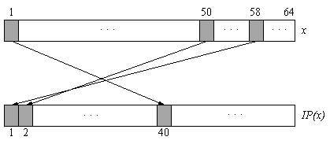
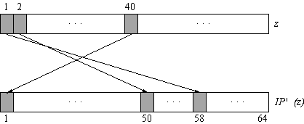
Initial and Final Permutation
Bitwise Permutations.
Inverse operations.
Described by tables IP and IP⁻¹.
Initial Permutation
Final Permutation

Slide 18
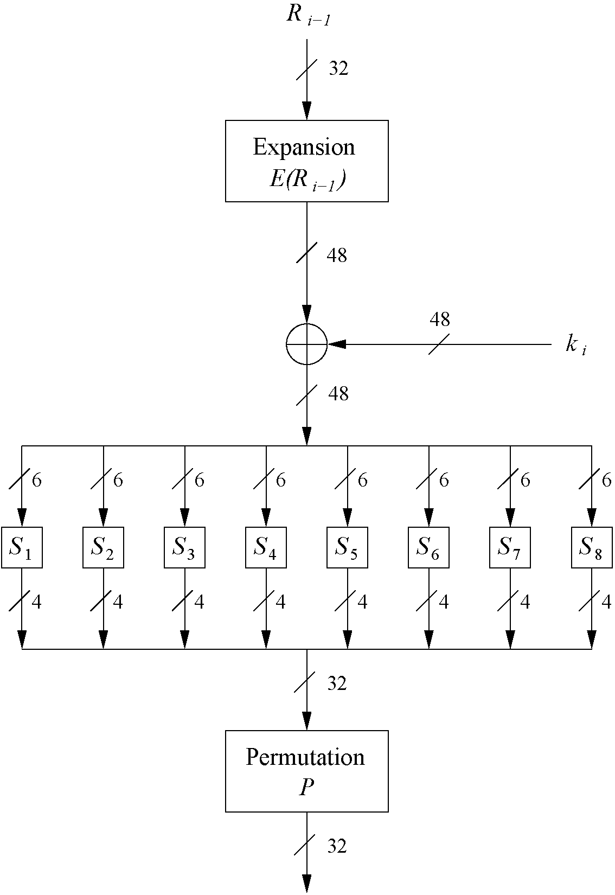
The f-Function
main operation of DES
f-Function inputs: R_{i-1} and round key k_{i}
4 Steps:
Expansion E
XOR with round key
S-box substitution
Permutation

Slide 19
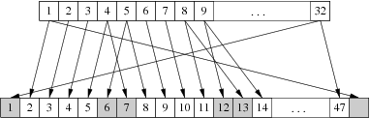
The Expansion Function E
Expansion E
main purpose: increases diffusion
!

Slide 20
Add Round Key
XOR Round Key
Bitwise XOR of the round key and the output of the expansion function E
Round keys are derived from the main key in the DES keyschedule (in a few slides)

Slide 21
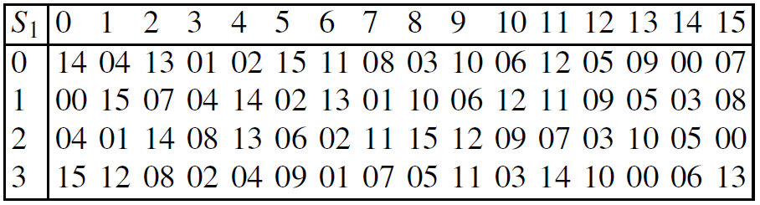
The DES S-Boxes
S-Box substitution
Eight substitution tables.
6 bits of input, 4 bits of output.
Non-linear and resistant to differential cryptanalysis.
Crucial element for DES security!
Find all S-Box tables and S-Box design criteria in Understanding Cryptography Chapter 3.

Slide 22
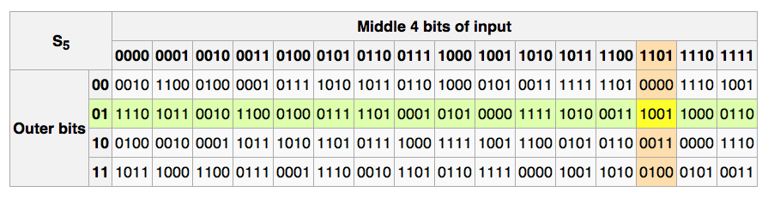
The S-boxes
Changing of one bit of input bits results in the change of at least two bits of the output bits.
S_{i}: {0,1}⁶ ⟶ {0,1}⁴

Slide 23
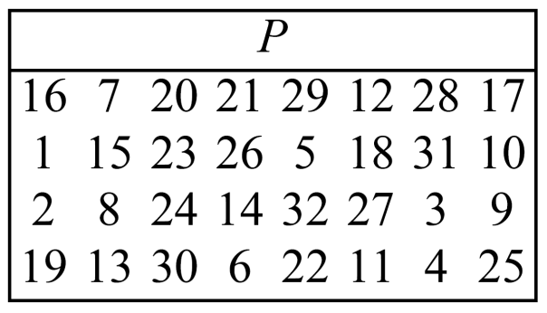
The Permutation P
Permutation P
Bitwise permutation.
Introduces diffusion.
Output bits of one S-Box effect several S-Boxes in next round
Diffusion by E, S-Boxes and P guarantees that after Round 5 every bit is a function of each key bit and each plaintext bit.

Slide 24
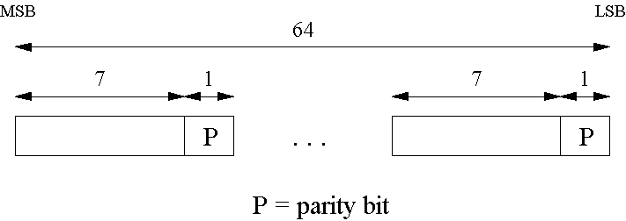
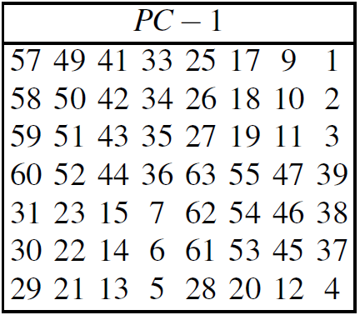
Key Schedule (1)
Derives 16 round keys (or subkeys) k_{i} of 48 bits each from the original 56 bit key.
The input key size of the DES is 64 bit: 56 bit key and 8 bit parity:
Parity bits are removed in a first permuted choice PC-1: (note that the bits 8, 16, 24, 32, 40, 48, 56 and 64 are not used at all)
!
Notes:
For applications with long term security needs, 128 bit keys should be considered. For thwarting against attacks with to-be-developed quantum computers, 256 bits are believed to be appropriate. Since a longer key usually does no carry a performance penality for symmetric algorithms, it is a prudent choice to use ciphers with a key lengths of around 128 bits.

Slide 25
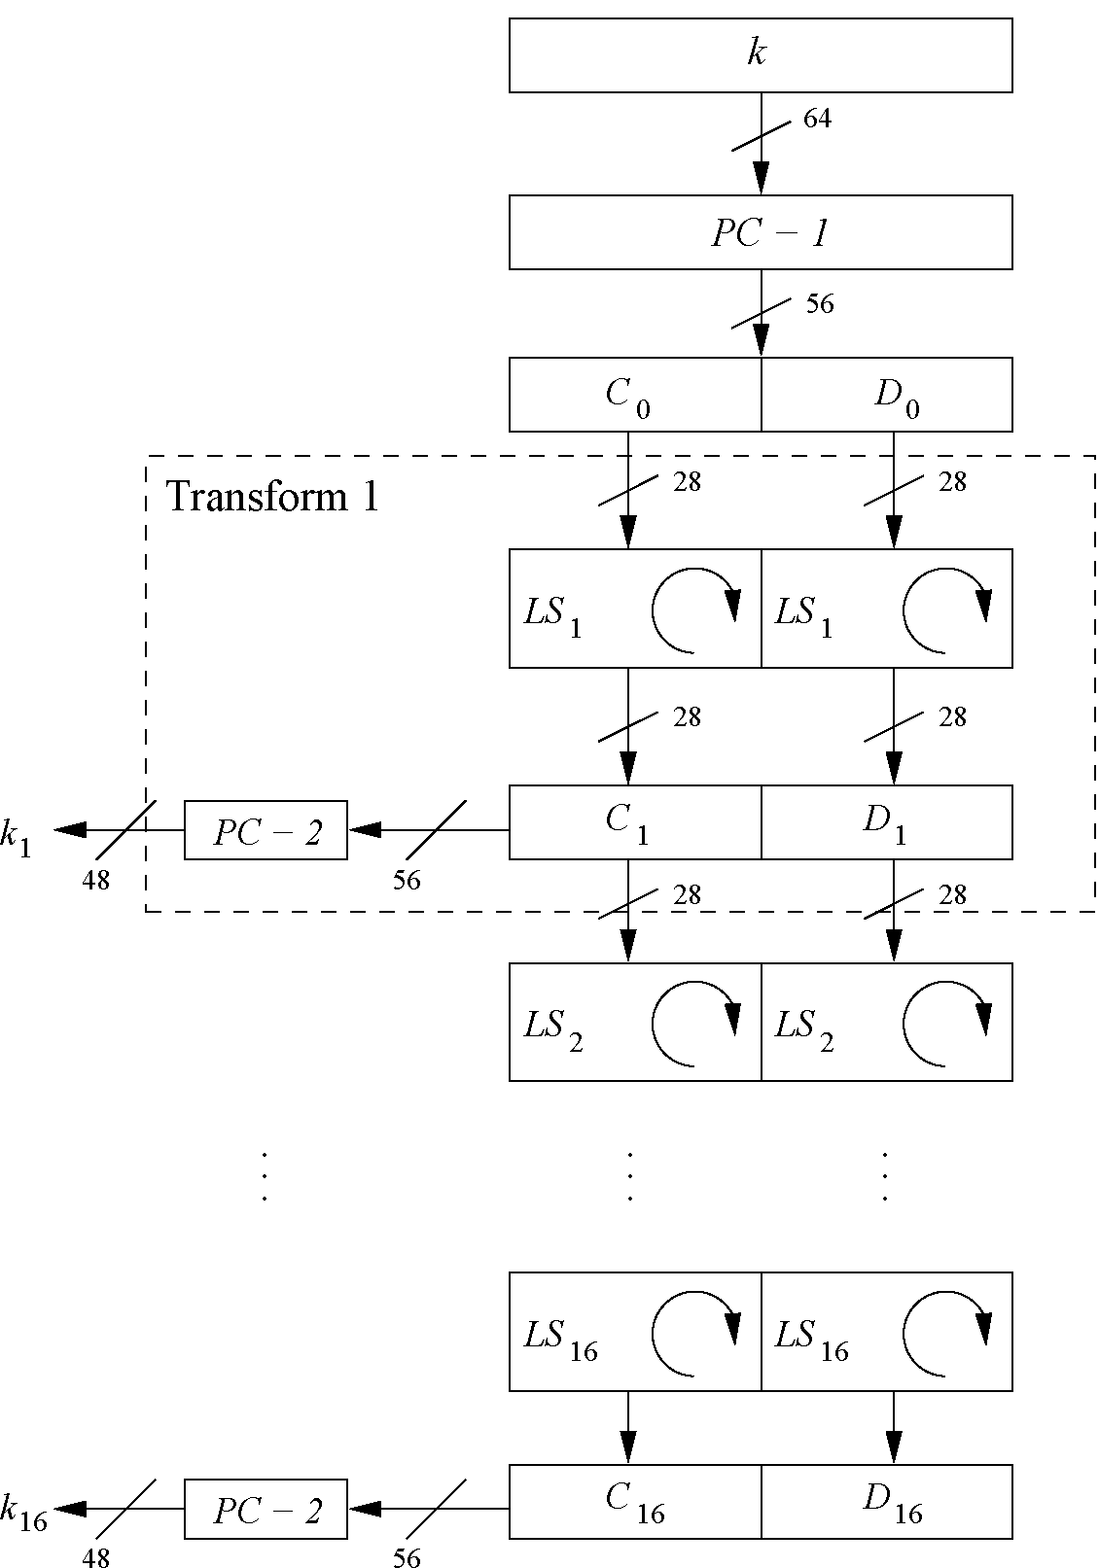
Key Schedule (2)
Split key into 28-bit halves C₀ and D₀.
In rounds i = 1, 2, 9 ,16, the two halves are each rotated left by one bit.
In all other rounds where the two halves are each rotated left by two bits.
In each round i permuted choice PC-2 selects a permuted subset of 48 bits of C_{i} and D_{i} as round key k_{i}, i.e. each k_{i} is a permutation of k!
Note: The total number of rotations: 4 x 1 + 12 x 2 = 28 ⇒ D₀ = D₁₆ and C₀ = C₁₆!
Notes:
For applications with long term security needs, 128 bit keys should be considered. For thwarting against attacks with to-be-developed quantum computers, 256 bits are believed to be appropriate. Since a longer key usually does no carry a performance penality for symmetric algorithms, it is a prudent choice to use ciphers with a key lengths of around 128 bits.

Slide 26
Content of this Chapter
Introduction to DES
Overview of the DES Algorithm
Internal Structure of DES
Decryption
Security of DES

Slide 27
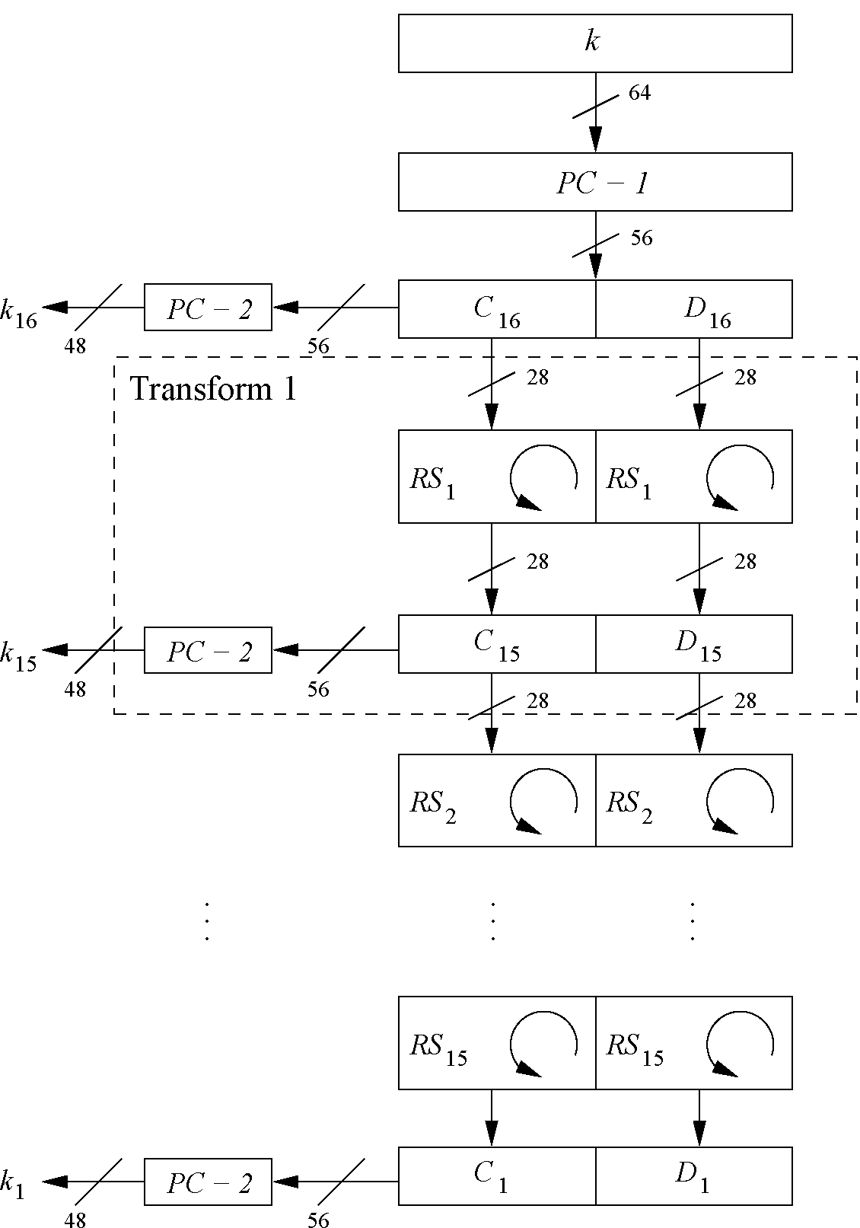
Decryption
In Feistel ciphers only the keyschedule has to be modified for decryption.
Generate the same 16 round keys in reverse order. (for a detailed discussion on why this works see Understanding Crptography Chapter 3)
Reversed key schedule: As D₀=D₁₆ and C₀=C₁₆ the first round key can be generated by applying PC-2 right after PC-1 (no rotation here!). All other rotations of C and D can be reversed to reproduce the other round keys resulting in:
No rotation in round 1.
One bit rotation to the right in rounds 2, 9 and 16.
Two bit rotations to the right in all other rounds.

Slide 28


DES: core idea – Feistel Network
Given functions f₁, …, f_{d}: {0,1}^{n} ⟶ {0,1}^{n}
Goal: build invertible function F: {0,1}^{2n} ⟶ {0,1}^{2n}
R₀
R₁
R₂
R_{d-1}
R_{d}
n-bits
f₁
f₂
⋯
f_{d}
L₀
L₁
L₂
L_{d-1}
L_{d}
n-bits
⊕
⊕
⊕
input
output
In symbols:

Slide 29
R₀
R₁
R₂
R_{d-1}
R_{d}
n-bits
f₁
f₂
⋯
f_{d}
L₀
L₁
L₂
L_{d-1}
L_{d}
n-bits
⊕
⊕
⊕
input
output
Claim: for all f₁, …, f_{d}: {0,1}^{n} ⟶ {0,1}^{n}
Feistel network F: {0,1}^{2n} ⟶ {0,1}^{2n} is invertible
Proof: construct inverse
R_{i-1}
R_{i}
R_{i-1} = L_{i}
L_{i-1} = f_{i}(L_{i}) ⨁ R_{i}
inverse
f_{i}
L_{i-1}
L_{i}
⊕

Slide 30
R₀
R₁
R₂
R_{d-1}
R_{d}
n-bits
f₁
f₂
⋯
f_{d}
L₀
L₁
L₂
L_{d-1}
L_{d}
n-bits
⊕
⊕
⊕
input
output
Claim: for all f₁, …, f_{d}: {0,1}^{n} ⟶ {0,1}^{n}
Feistel network F: {0,1}^{2n} ⟶ {0,1}^{2n} is invertible
Proof: construct inverse
R_{i-1}
R_{i}
R_{i}
⊕
R_{i-1}
inverse
f_{i}
L_{i}
f_{i}
L_{i-1}
L_{i-1}
L_{i}
⊕

Slide 31
Decryption circuit
R_{d}
⊕
⊕
⊕
n-bits
R_{d-1}
R_{d-2}
R₁
R₀
⋯
f_{d}
f_{d-1}
f₁
L_{d}
L_{d-1}
L_{d-2}
L₁
L₀
n-bits
Inversion is basically the same circuit, with f₁, …, f_{d} applied in reverse order
General method for building invertible functions (block ciphers) from arbitrary functions.
Used in many block ciphers … but not AES

Slide 32
Content of this Chapter
Introduction to DES
Overview of the DES Algorithm
Internal Structure of DES
Decryption
Security of DES

Slide 33
Security of DES
After proposal of DES two major criticisms arose:
Key space is too small (2⁵⁶ keys)
S-box design criteria have been kept secret: Are there any hidden analytical attacks (backdoors), only known to the NSA?
Analytical Attacks: DES is highly resistent to both differential and linear cryptanalysis, which have been published years later than the DES. This means IBM and NSA had been aware of these attacks for 15 years! So far there is no known analytical attack which breaks DES in realistic scenarios.
Exhaustive key search: For a given pair of plaintext-ciphertext (x, y) test all 2⁵⁶ keys until the condition DES_{k}⁻¹(y)=x is fulfilled. ⇒ Relatively easy given today’s computer technology!
Notes:
The major weakness of the method is that each plaintext symbol always maps to the same ciphertext symbol. That means that the statistical properties of the plaintext are preserved in the ciphertext. For practical attacks, the following properties of language can be exploited:
Determine the frequencies of every ciphertext letter. The frequency distribution (even of relatively short pieces of encrypted text) will be close to that of the given language in general. In particular, the most frequent letters (for instance, in English: „e“ is the most frequent one with about 13%, „t“ is the second most frequent one with about 9%, „a“ is the third most frequent one with about 8%, ...) can often easily be spotted in ciphertext.
The method above can be generalized by looking at pairs (or triples, or quadruples, or ...) of ciphertext symbols. For instance, in English (and German and other European languages), the letter „q“ is almost always followed by a „u“. This behavior can be exploited for detecting the substitution of the letter „q“ and the letter „u“.
If we assume that word separators (blanks) have been found (which is often an easy task), one can often detect frequent short words such as „the“, „and“, ... , which leaks all the letters in the words involved in those words

Slide 34
History of Attacks on DES
Year | Proposed/ implemented DES Attack
1977 | Diffie & Hellman, (under-)estimate the costs of a key search machine
1990 | Biham & Shamir propose differential cryptanalysis (2⁴⁷ chosen ciphertexts)
1993 | Mike Wiener proposes design of a very efficient key search machine: Average search requires 36h. Costs: $1.000.000
1993 | Matsui proposes linear cryptanalysis (2⁴³ chosen ciphertexts)
Jun. 1997 | DES Challenge I broken, 4.5 months of distributed search
Feb. 1998 | DES Challenge II--1 broken, 39 days (distributed search)
Jul. 1998 | DES Challenge II--2 broken, key search machine Deep Crack built by the Electronic Frontier Foundation (EFF): 1800 ASICs with 24 search engines each, Costs: $250 000, 15 days average search time (required 56h for the Challenge)
Jan. 1999 | DES Challenge III broken in 22h 15min (distributed search assisted by Deep Crack)
2006-2008 | Reconfigurable key search machine COPACOBANA developed at the Universities in Bochum and Kiel (Germany), uses 120 FPGAs to break DES in 6.4 days (avg.) at a cost of $10 000.

Slide 35


Triple DES – 3DES
Triple encryption using DES is often used in practice to extend the effective key length of DES to 112. For more info on multiple encryption and effective key lengths see Chapter 5 of Understanding Cryptography.
Alternative version of 3DES: Advantage: choosing k₁=k₂=k₃ performs single DES encryption.
No practical attack known today.
Used in many legacy applications, i.e., in banking systems.

Slide 36
Alternatives to DES
Algorithm | I/O Bit | key lengths | remarks
AES / Rijndael | 128 | 128/192/256 | DES ''replacement'', worldwide used standard
Triple DES | 64 | 112 (effective) | conservative choice
Mars | 128 | 128/192/256 | AES finalist
RC6 | 128 | 128/192/256 | AES finalist
Serpent | 128 | 128/192/256 | AES finalist
Twofish | 128 | 128/192/256 | AES finalist
IDEA | 64 | 128 | (Patented till 2011)

Slide 37
Lessons Learned
DES was the dominant symmetric encryption algorithm from the mid-1970s to the mid-1990s. Since 56-bit keys are no longer secure, the Advanced Encryption Standard (AES) was created.
Standard DES with 56-bit key length can be broken relatively easily nowadays through an exhaustive key search.
DES is quite robust against known analytical attacks: In practice it is very difficult to break the cipher with differential or linear cryptanalysis.
By encrypting with DES three times in a row, triple DES (3DES) is created, against which no practical attack is currently known.
The “default” symmetric cipher is nowadays often AES. In addition, the other four AES finalist ciphers all seem very secure and efficient.

